Slide 1

Random Forest Proximities and Their Applications in Data Science
Jake Rhodes
Brigham Young University

Slide 2


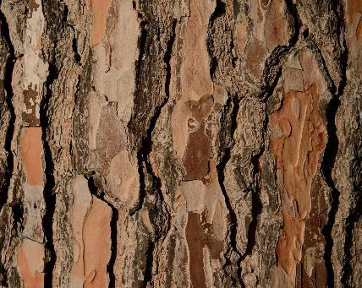

Outline
Classification and Regression Trees
What are they?
How to optimize?
Benefits and Limitations
Random Forests
Randomizations
Out-of-Bag Points
Predictions
Proximities

Slide 3

Decision Making
Suppose you would like to buy a car. What are some aspects you need to consider? What are the most important variables for your decision?

Slide 4




CART
Classification and Regression Trees
Predictive models
Sequences of binary questions (yes/no)
Make predictions by following paths and voting/aggregating responses.

Slide 5
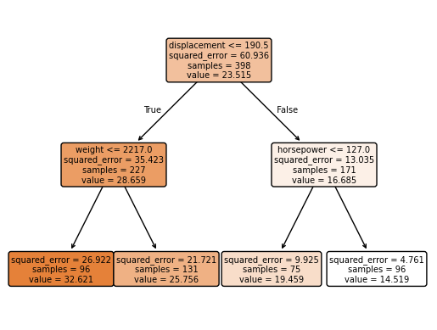
CART Terminology
Decision Tree: Estimate MGP
Nodes:
Root (Beginning)
Terminal or Leaf (End)
Daughter/ (Internal)
Splits:
Splitting Variables (What)
Split Points (Where)
Splitting Criteria (Why/How)

Slide 6
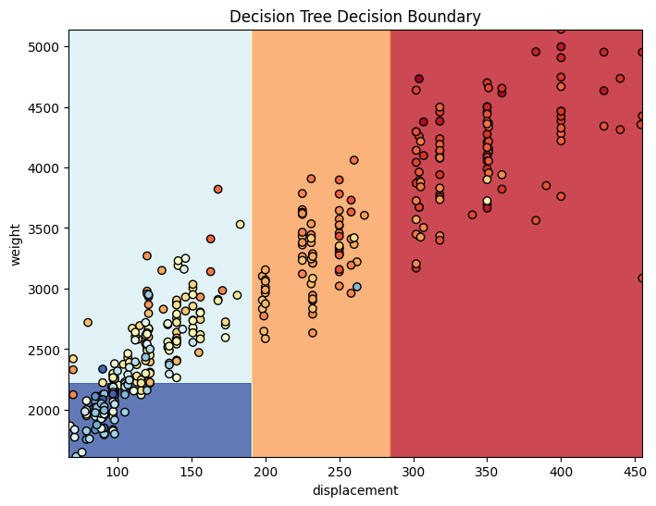
CART Decision Boundaries
Splits form orthogonal decision regions.
Splits spanning the space come first.
Early variables → important

Slide 7

Mechanics of CART
How to determine which variables?
Which questions to ask first?
How to determine split points?
What process optimizes the decision-making?
Notes:
Have the students try to figure out answers to these questions.

Slide 8
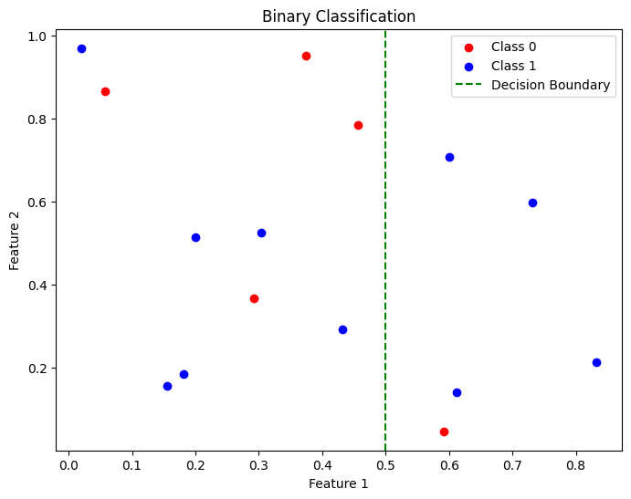
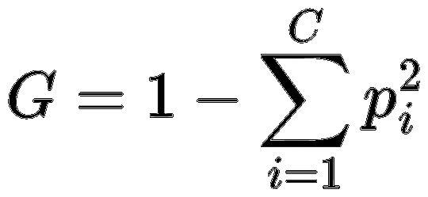
CART: Optimizing Splits (Classification)
GINI Impurity
Impurity Example
Quantifies the probability of misclassifying a randomly chosen data point if it's labeled according to the class distribution.
A lower Gini Impurity (closer to 0) indicates a purer node (e.g., all one class)

Slide 9
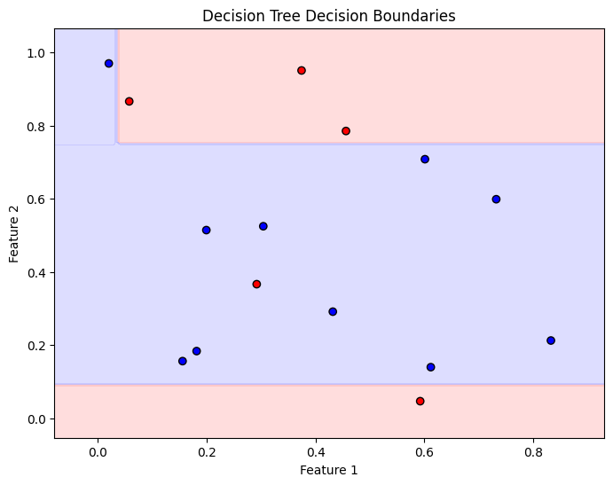
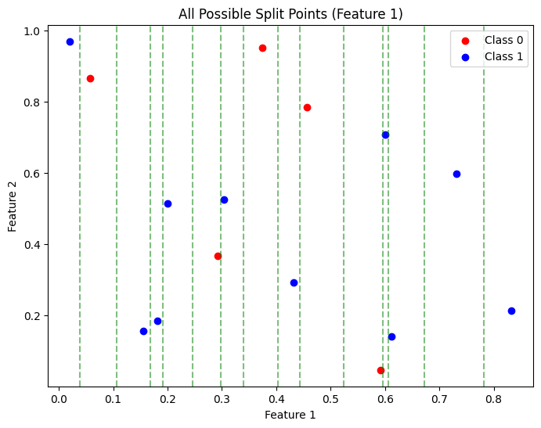
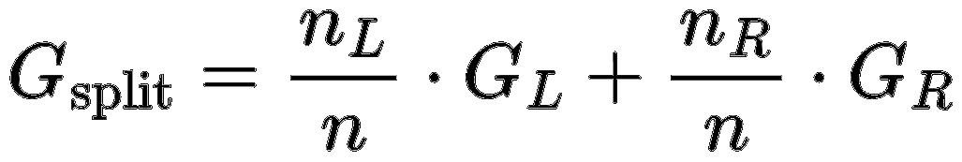
CART: Optimization Steps
GINI Optimization
Binary classification
Evaluate all possible splits
Median between continuous values
Subsets/groupings of categorical
Partition the data by split
Compute Gini impurity by branch
Calculate weighted impurity
Choose split by min. impurity

Slide 10
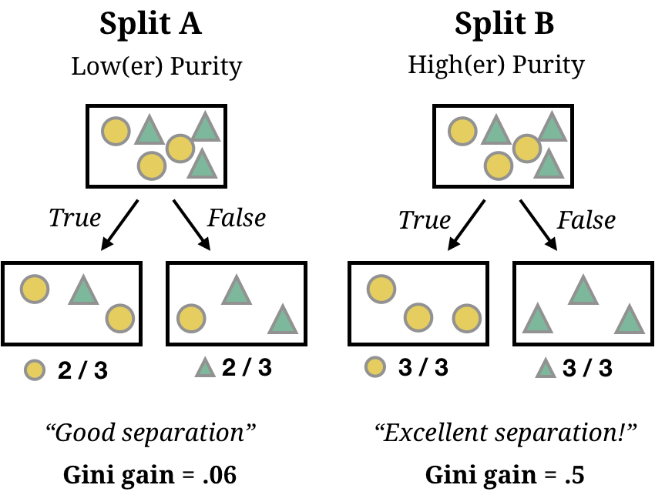
Other Considerations
Parameters et. al
When to stop splitting?
Depth of the tree?
Control for complexity.
Data encoding.
Data preparation.
Feature selection.

Slide 11
CART: Benefits and Limitations
Benefits
Limitations
Both Classification and Regression
Scale Invariant (rank-based)
Learns Non-Linear Relationships
Interpretable
Mixed Variable Types
Low Performing
High Variance
Easily Overfit

Slide 12

Random Forests
Overcoming CART’s Limitations

Slide 13

But first.. a little game!

Slide 14
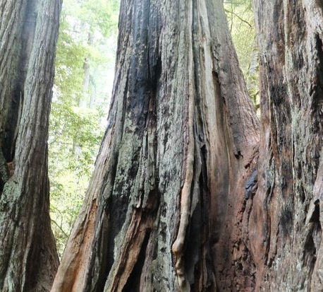
Ensemble Methods
Combine predictions from multiple models to produce more accurate/more stable results.
Typically, a collection of “weak” learners

Slide 15
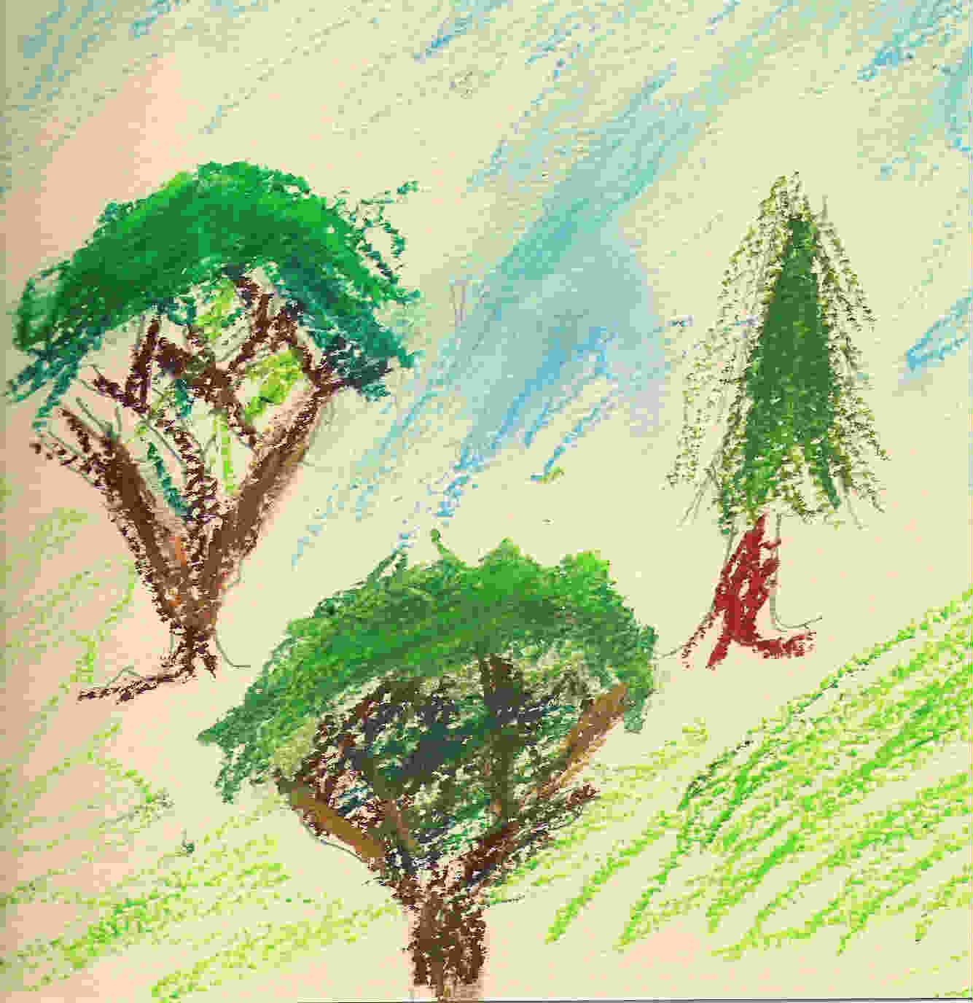
Random Forest
An ensemble of randomized CART decision trees.
Combining trees beneficial if uncorrelated.
Two-part randomization.

Slide 16


Recall: CART Limitations
Cart
Random forests
High variance
Easy to overfit.
Decreased variance (ensembling)
Less sensitive to outliers

Slide 17
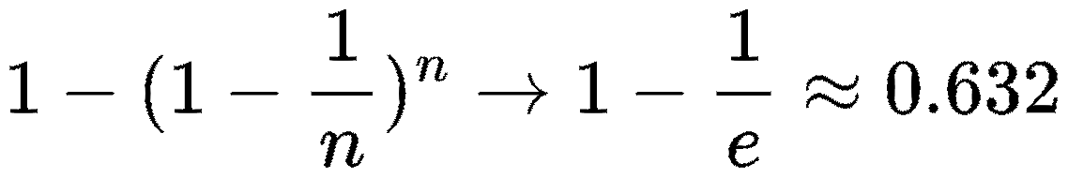
Random Forest Randomizations
Bootstrapping
Random Feature Selection
For each tree, data is sampled with replacement
Sampled data: In-bag
Otherwise: Out-of-bag
P(In-Bag) -->
At each split, m variables considered
For classification: m = sqrt(d)
For regression: m = (1/3)d

Slide 18

Out-of-Bag Points
OOB pts. unseen by about 37% of trees
Serval as an internal validation set.
Used to estimate generalization error.
Can serve as cross-validation for hyperparameter tuning

Slide 19
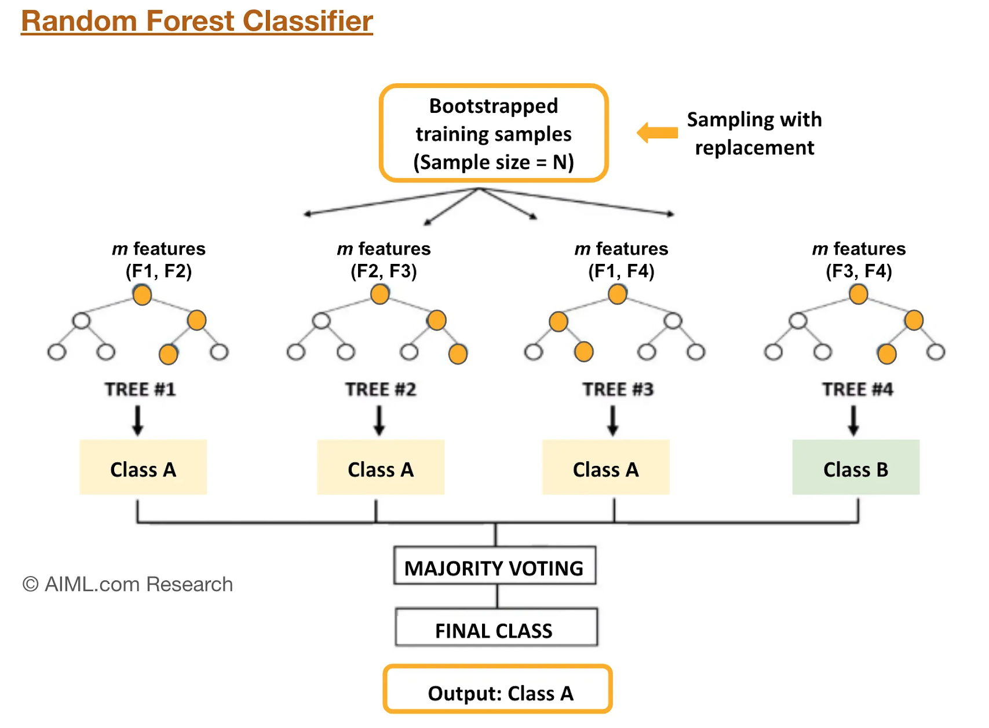
Random Forest Predictions
Each tree provides one vote
Unweighted majority voting
Weights implicitly defined in trees
Averaging for regression

Slide 20

Benefits of Random Forests
Classification and regression
Mixed variable types
Estimate of generalization error
Trivially parallelizable
Scale invariant
Insensitive to outliers in predictor space
Model non-linear relationships
Natural produce a measure of similarity

Slide 21
Random Forest Proximities
“[Proximities] are one of the most useful tools in random forests.”
--Leo Breiman
Original description:
“The proximities originally formed a NxN matrix. After a tree is grown, put all of the data, both training and oob, down the tree. If cases k and n are in the same terminal node increase their proximity by one. At the end, normalize the proximities by dividing by the number of trees.”
https://www.stat.berkeley.edu/~breiman/RandomForests/cc_home.htm#:~:text=few%20data%20sets.-,Proximities,by%20the%20number%20of%20trees.

Slide 22
Proximities in a Nutshell
“Proximities don’t just measure the similarity of the variables---they also take into account the importance of the variables.”
“Two cases that have quite different predictor variables might have large proximity if they differ only on variables that are not important.”
“Two cases that have quite similar values of the predictor variables might have small proximity if they differ on inputs that are important.”
--Adele Cutler

Slide 23
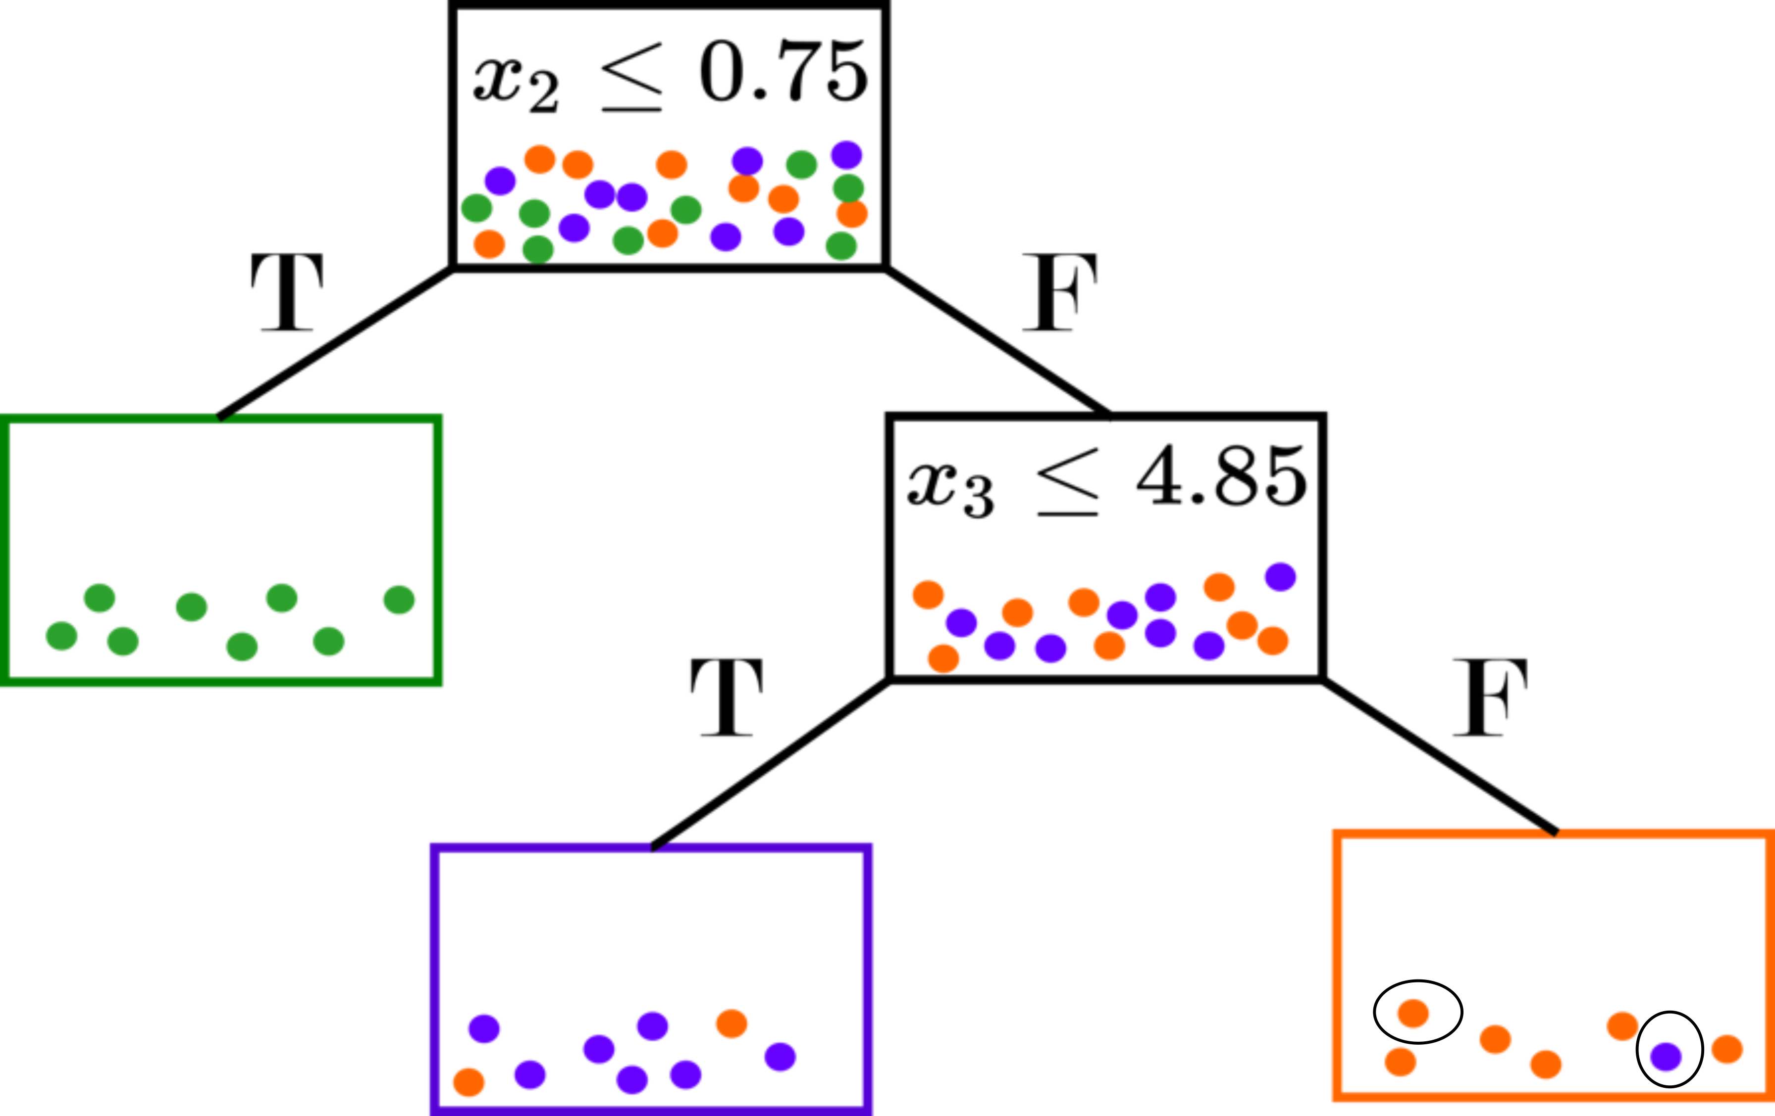
What are Random Forest Proximities
Proximities as a metric
A measure of “closeness”
Supervised, but not class-conditional
Based on splits (optimized over responses)
Natural incorporation of variable importance

Slide 24
Applications of Proximities
Visualization
Imputation
Outlier Detection
Uncertainty Quantification
Manifold Learning/Alignment

Slide 25
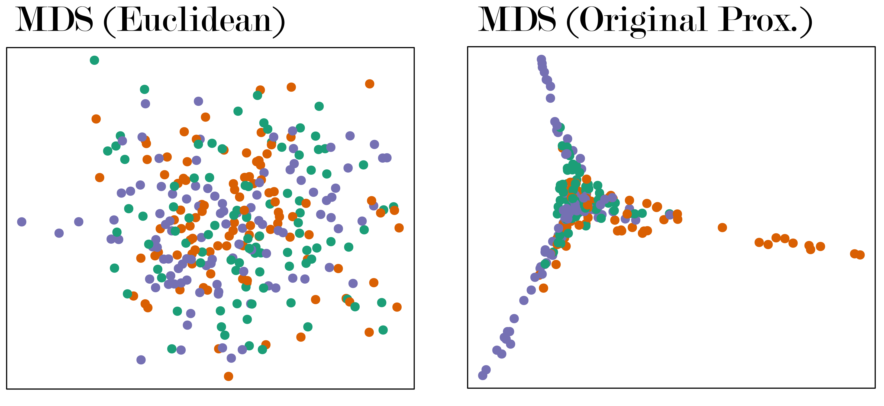
Other Proximity Considerations
Overfit if use all training data
Trees grown until pure (typically)
In-bag points of different classes always in different nodes
Exaggerate class separation
A random sample of 300 points generated from a bivariate normal distribution was randomly assigned one of three classes. MDS was applied to 1 – proximities.

Slide 26
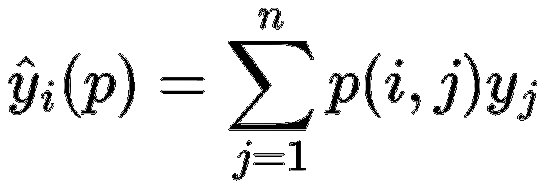
Proximities as Neighbor-based Predictor
What do we want?
The similarity measure to encapsulate the supervised learning from the random forest!
E.g., we want a proximity-weighted predictor to match the RF OOB predictions.
This is not the case with the original definition, even when limiting it to OOB points only.
Why does this not work?
The voting mechanism in random forests considers all training instances, not just pairwise relationships.
Similar to SVM Predictions:

Slide 27
Accuracy Preserving Proximities
Account for Prediction
Proximities to be defined between an OOB point and all “similar” training points.
Tree-wise proximities proportionate to size of terminal node.
Proximity weighted predictor matches OOB or test predictions.

Slide 28
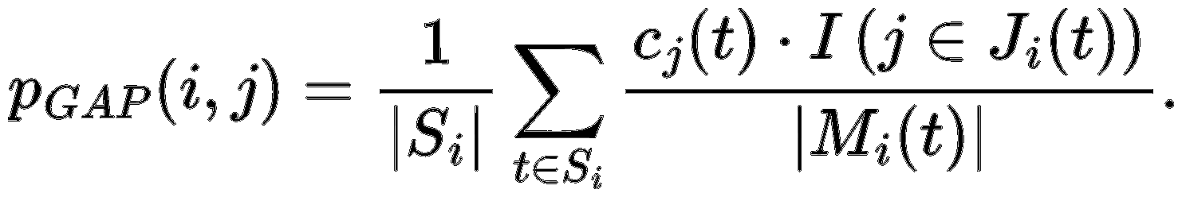
Random Forest Geometry- and Accuracy-Preserving Proximities
T: Set of trees in the forest (|T| = T)
Sᵢ: Trees where obs. i is OOB
Jᵢ(t): In-bag indices in node with i in tree t
Mᵢ(t): Multiset of in-bag indices in i’s terminal node
cⱼ(t): In-bag count of obs. J in tree t.

Slide 29
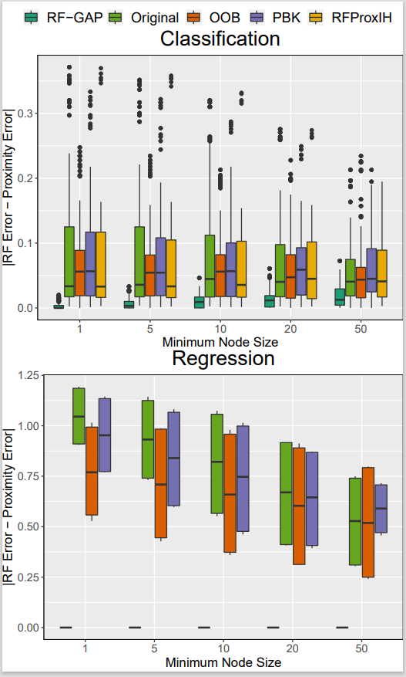
Proximity-Weighted Errors
As desired, RF predictions match proximity predictions
(Results aggregated across 24 datasets/10 repetitions)

Slide 30
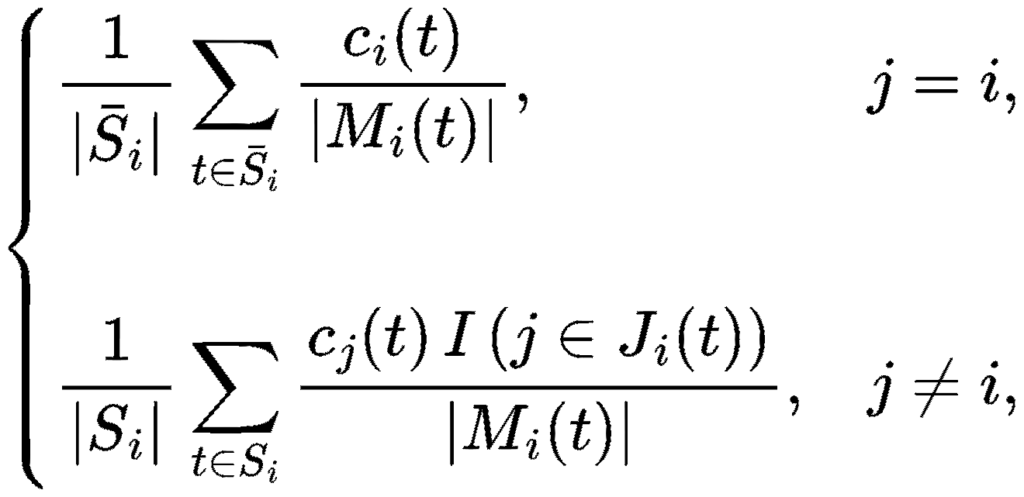
RF-GAP Proximities Notes
RF-GAP proximities are not symmetric!
By design, p(i, i) = 0 to serve as proper weights for RF predictions.
For some applications, we must reassign self-similarity and symmetrize.
This guarantees that self-similarity is maximal but on the same scale.

Slide 31
Bonus Applications

Slide 32
Oversampling

Slide 33
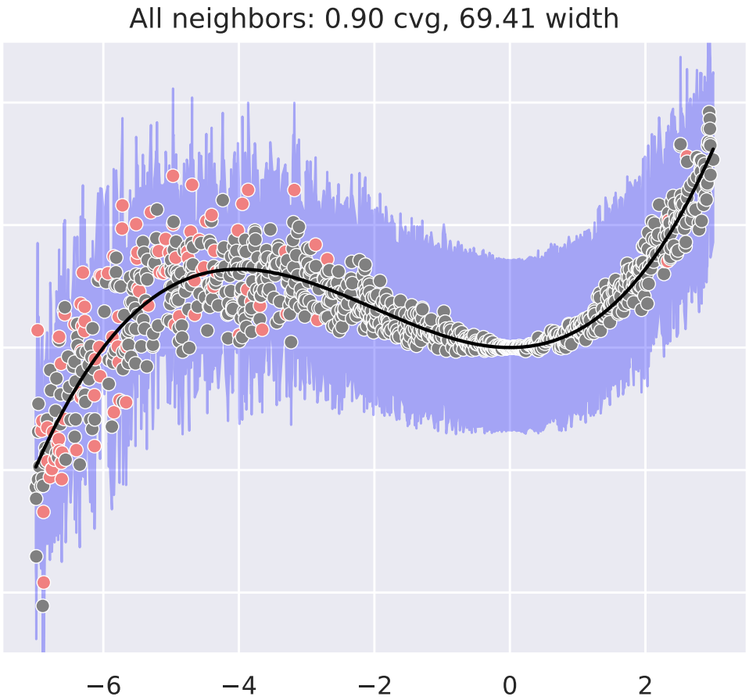
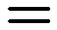
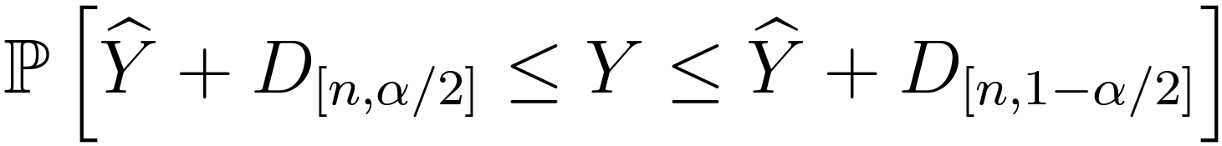
Intervals from Out-of-Bag Error Distribution (Haozhe Zhang and Nordman, 2020)

Slide 34
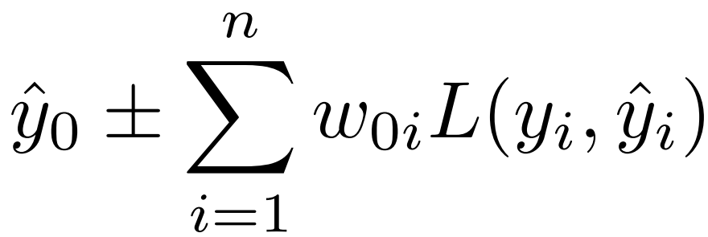
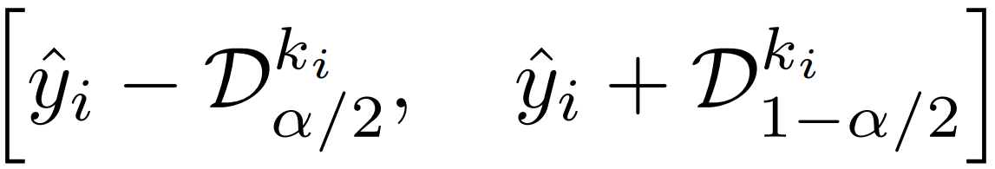
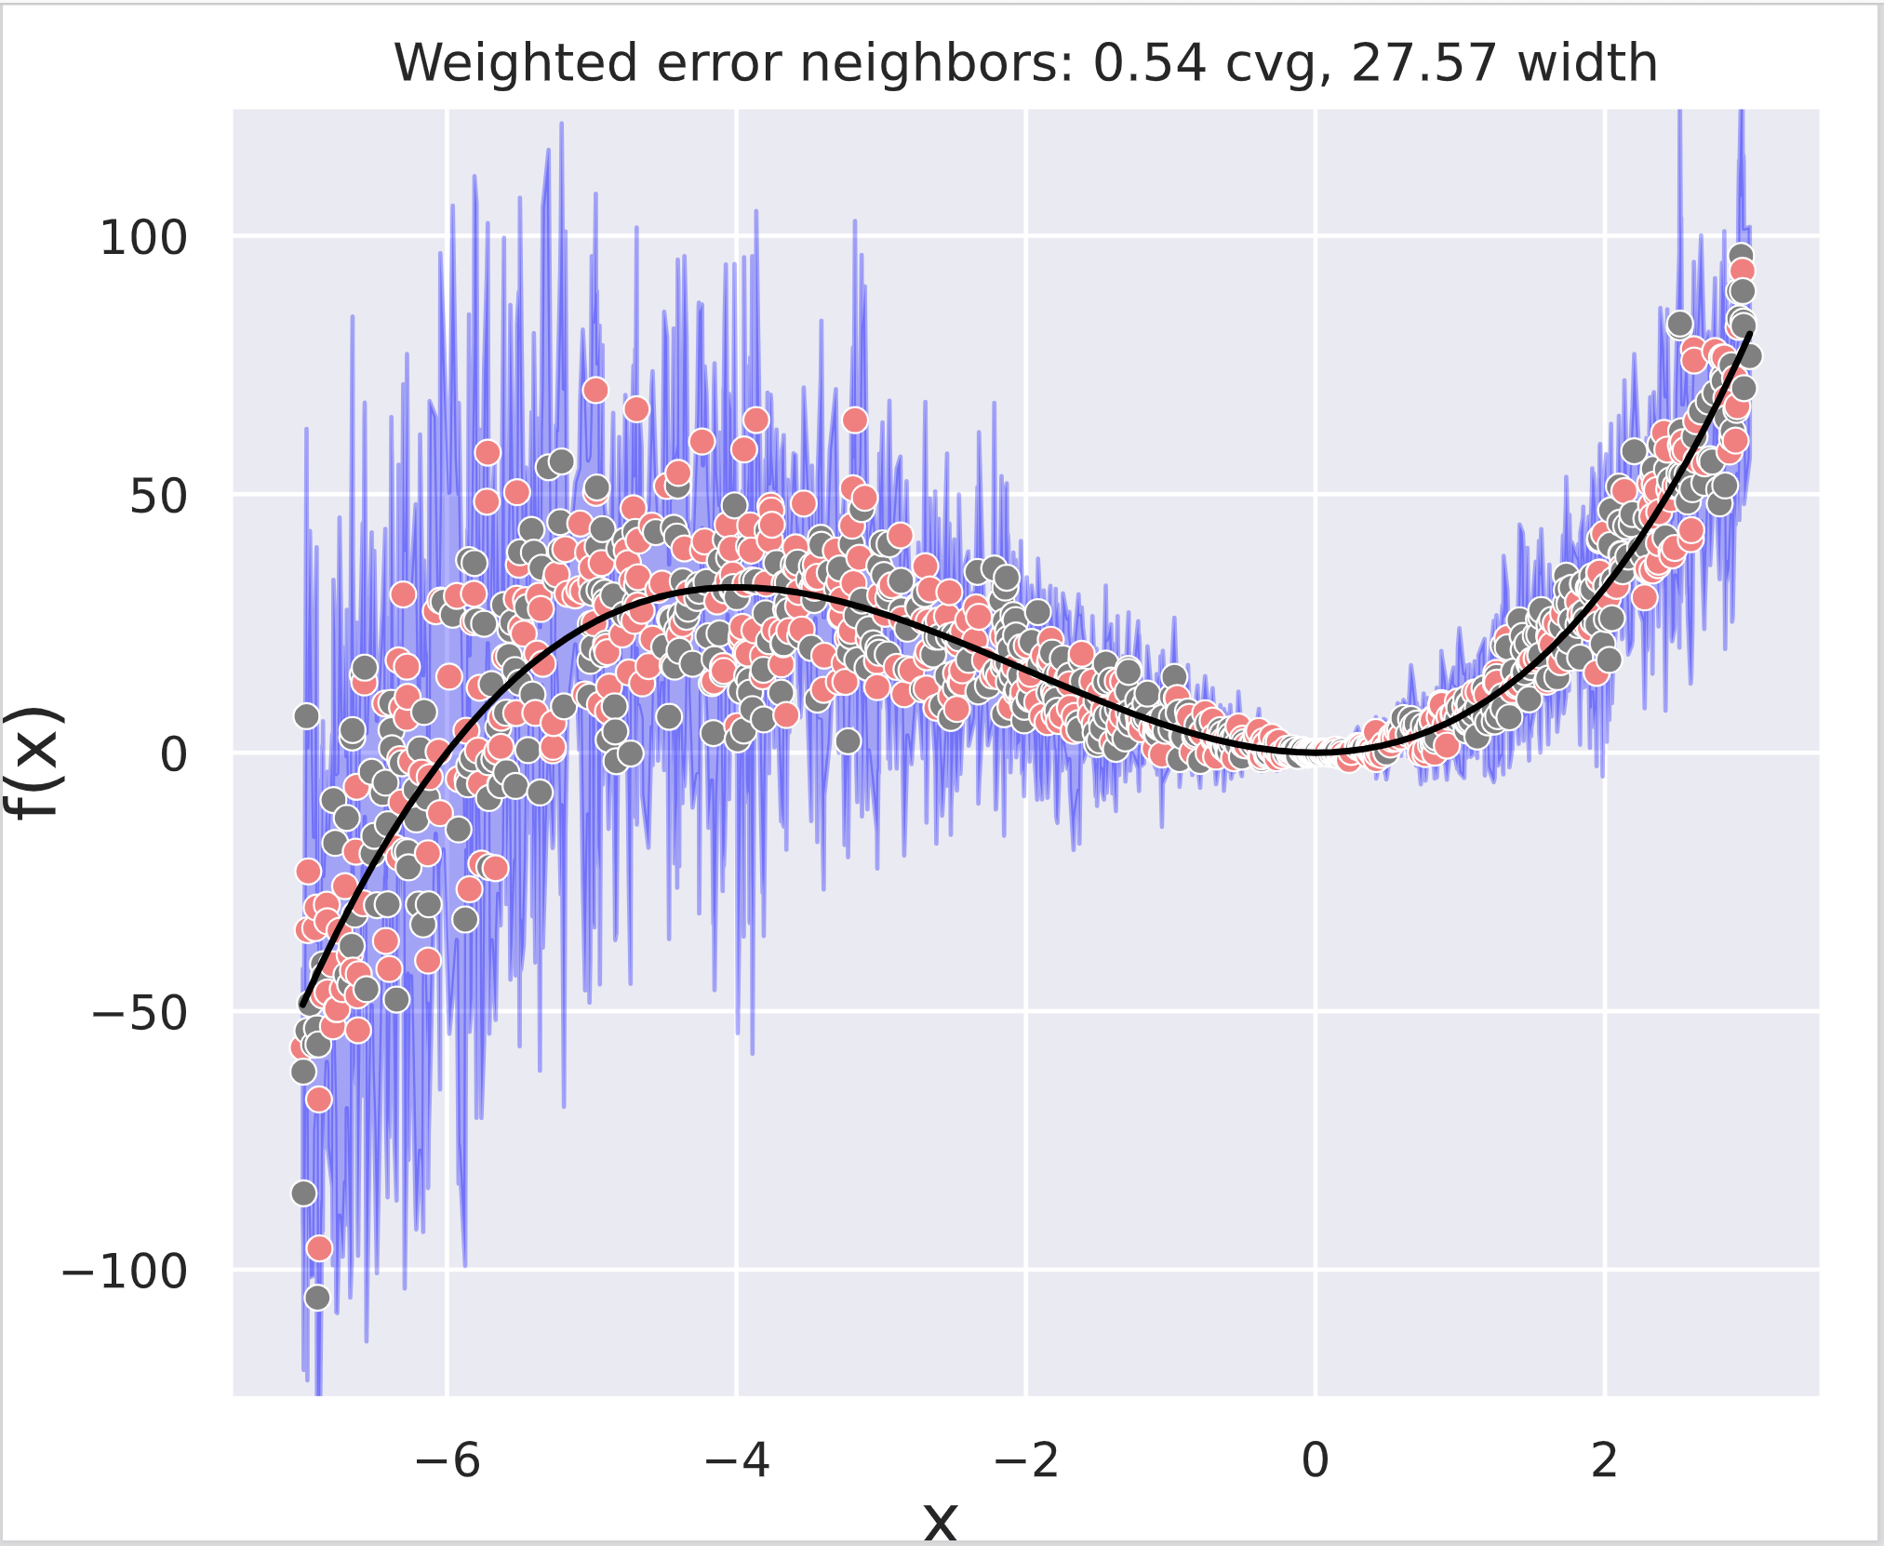
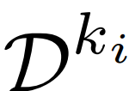
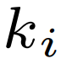
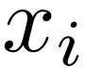

Regression – Prediction Intervals
Random Forest Interval Residual Estimation (RF-FIRE)
(1) Weighted out-of-bag errors:
(2) Localized error distribution:
Where:
is the distribution of OOB errors limited to the nearest* neighbors of .
*Nearest based on RF-GAP proximity

Slide 35
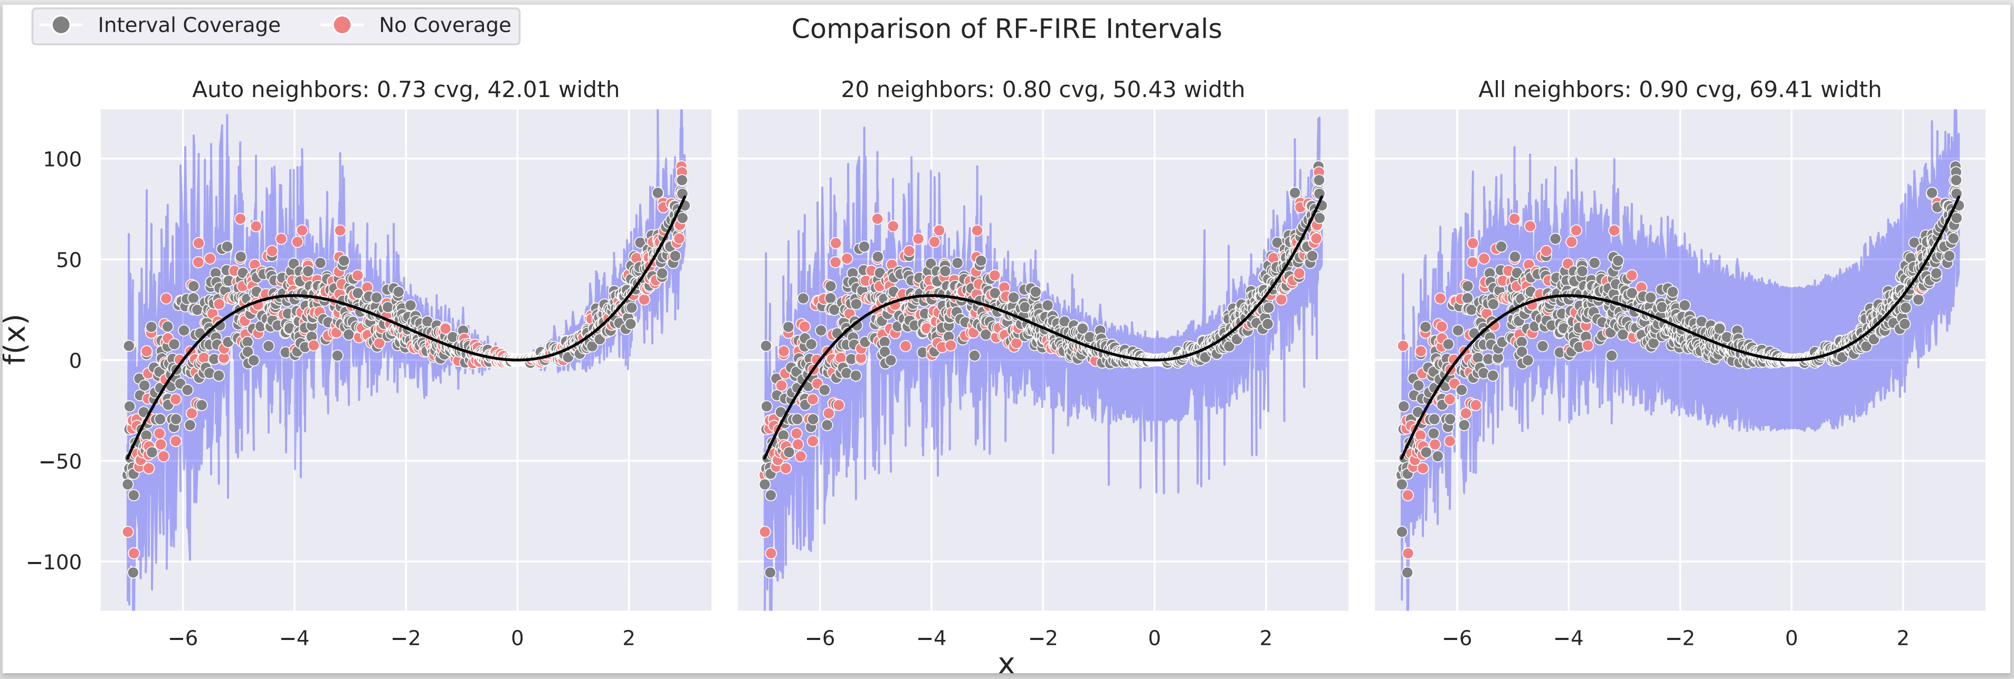
Regression – RF-FIRE (Localized Error Dist.)

Slide 36
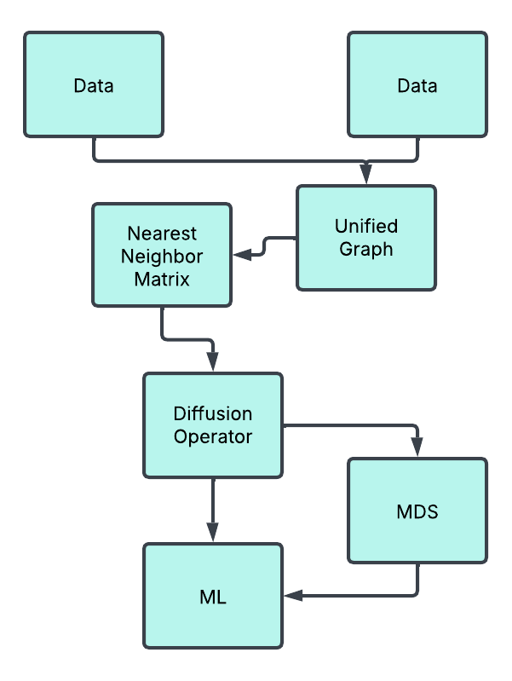

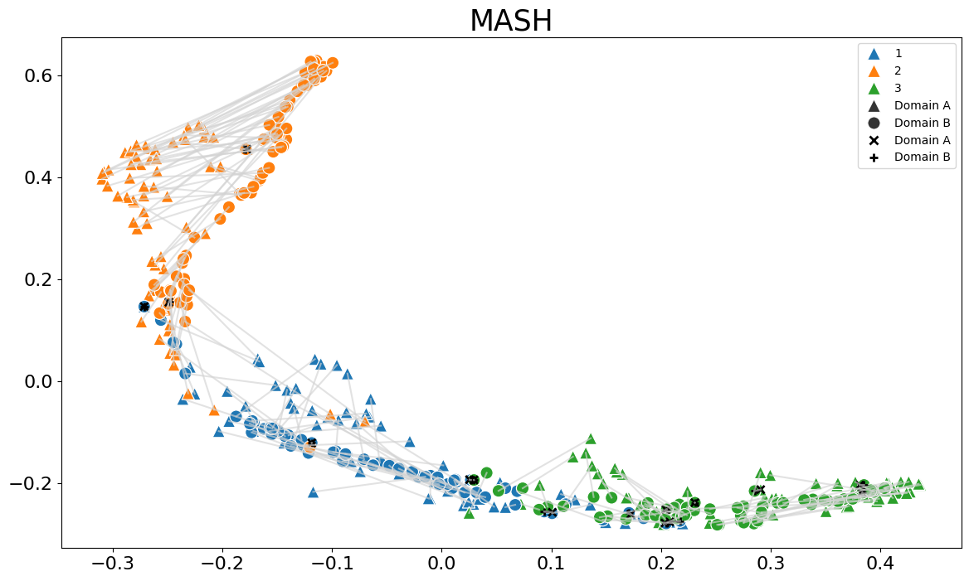
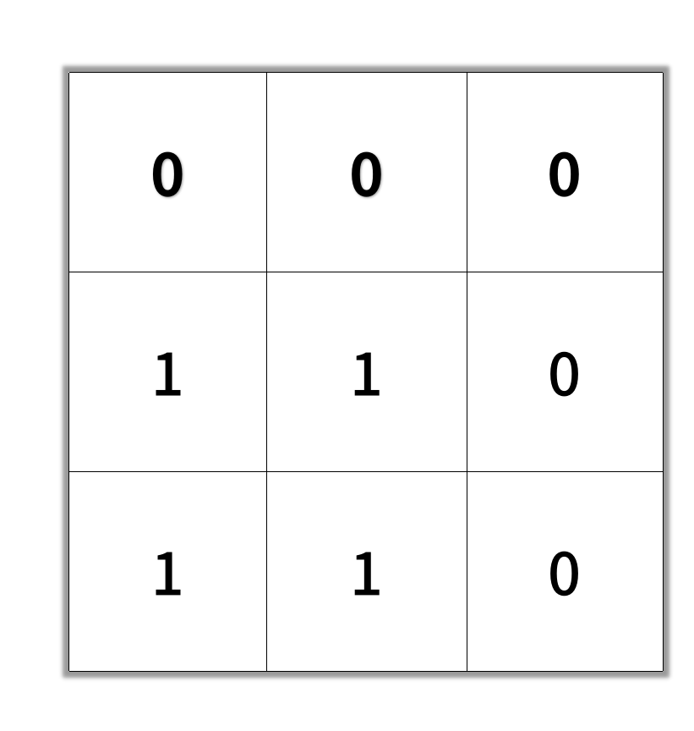
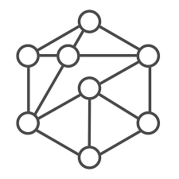
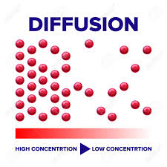


RF-Manifold Alignment
RF-MASH’s resulting manifold on the seeds data set

Slide 37
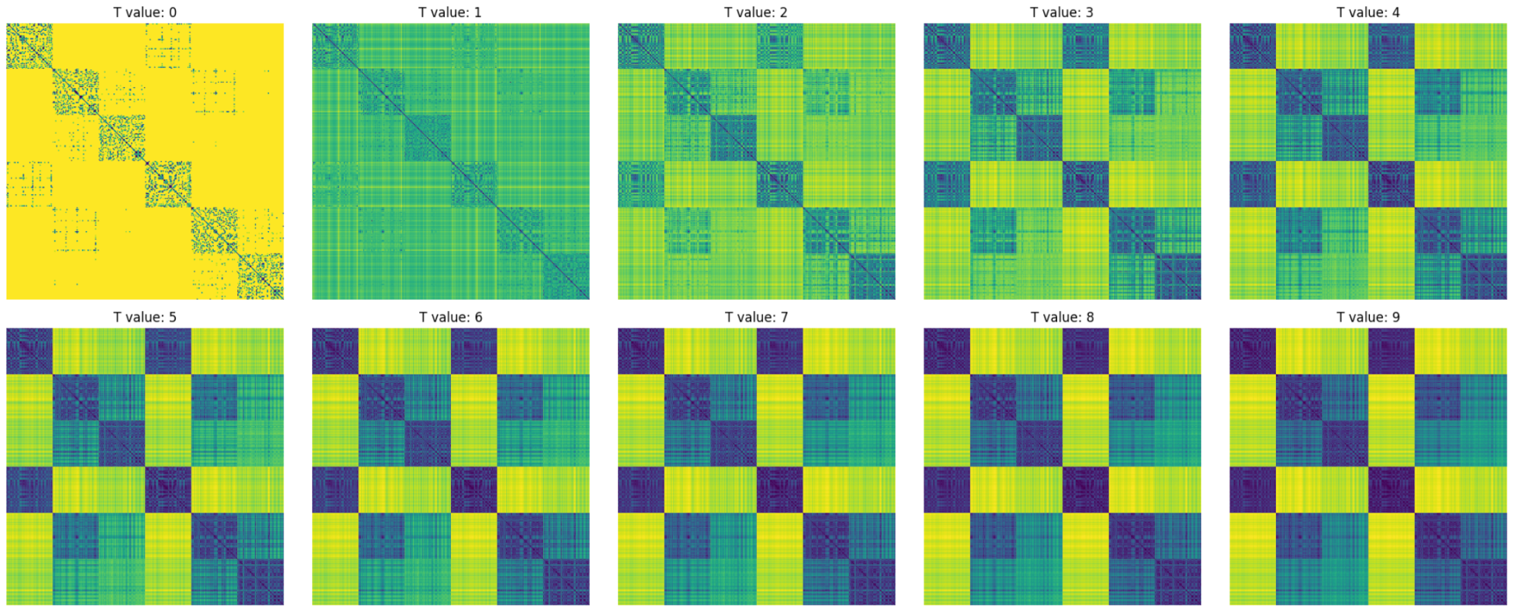
Diffusion over Combined Proximities

Slide 38
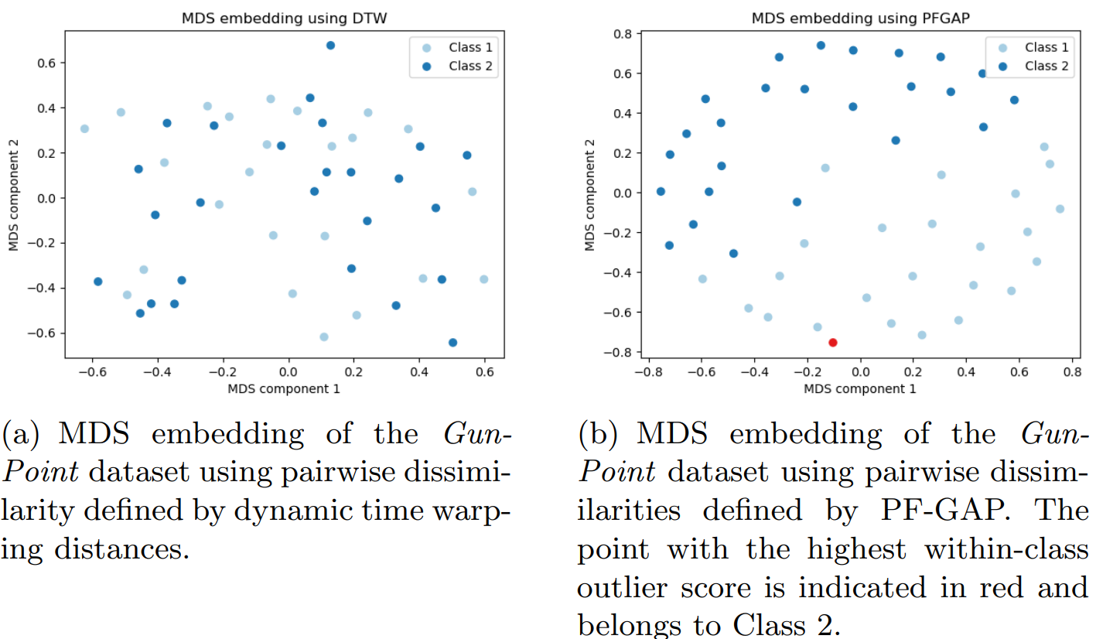
Time Series Classification – Proximity Forests

Slide 39
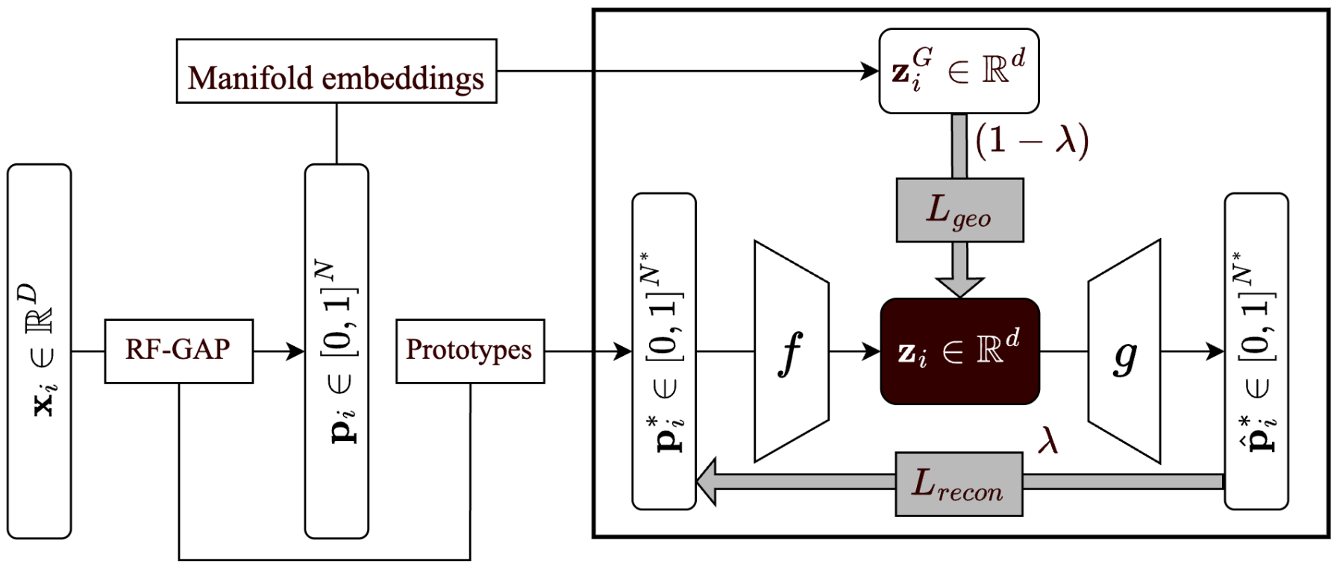
Random Forest Autoencoders

Slide 40
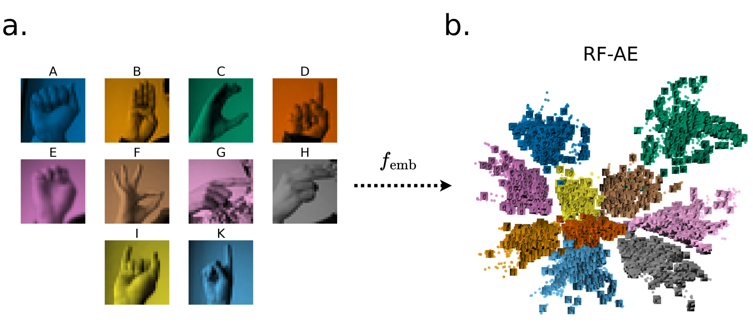
RF-AE Example

Slide 41


The way to get started is to quit talking and begin doing.
Walt Disney

Slide 42

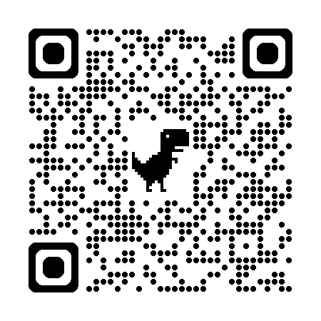
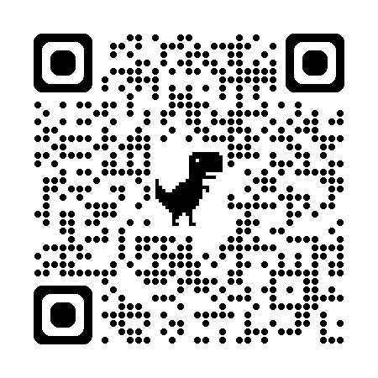
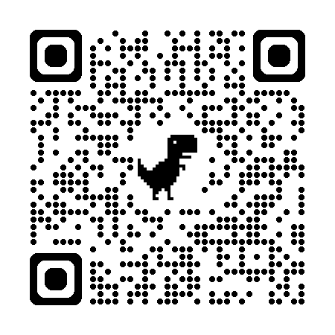
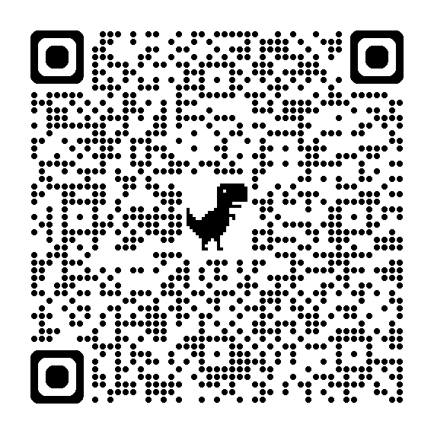
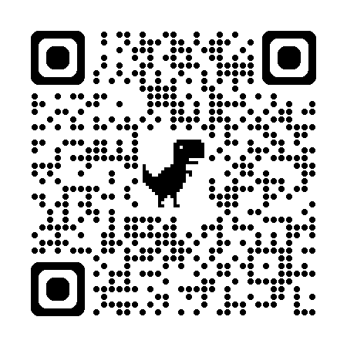
Thank you
RF-PHATE
Time Seres (PF-GAP)
RF-GAP
RF-MA
RF-AE

